Slide 1
Introduction to AI

Slide 2
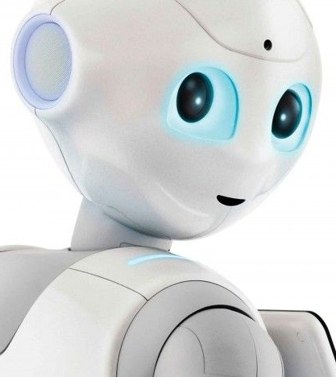
What is Artificial Intelligence?
Artificial Intelligence is the development of computer systems that are able to perform tasks that would require human intelligence.
Examples of these tasks are visual perception, speech recognition,
decision-making, and translation between languages.

Slide 3
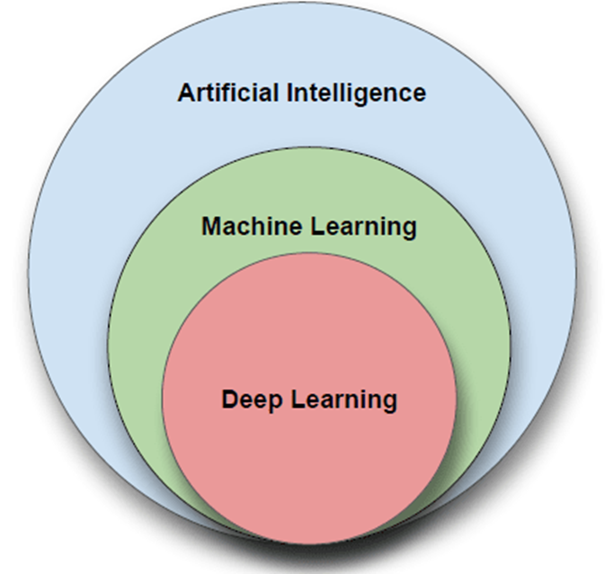
Are AI and Machine Learning the Same?
Machine Learning is a subset of AI, meaning that all ML systems are part of AI, but not all AI systems involve ML.
• AI: The broader concept that encompasses any technique that enables computers to mimic human intelligence.
• ML: A specific approach within AI that uses data and algorithms to enable computers to learn and improve from experience without being explicitly programmed for each task.
While AI represents the overarching goal of creating intelligent systems, ML provides one of the primary methods for achieving this goal.
© Copyright IBM Corporation 2024
Notes:
There are different ways to make machines intelligent:
Learning from data: Machines analyze tons of information, like photos or text, to learn patterns and improve their skills.
Thinking like brains: Inspired by how our brains work, some AI programs use "artificial neural networks" to process information.

Slide 4
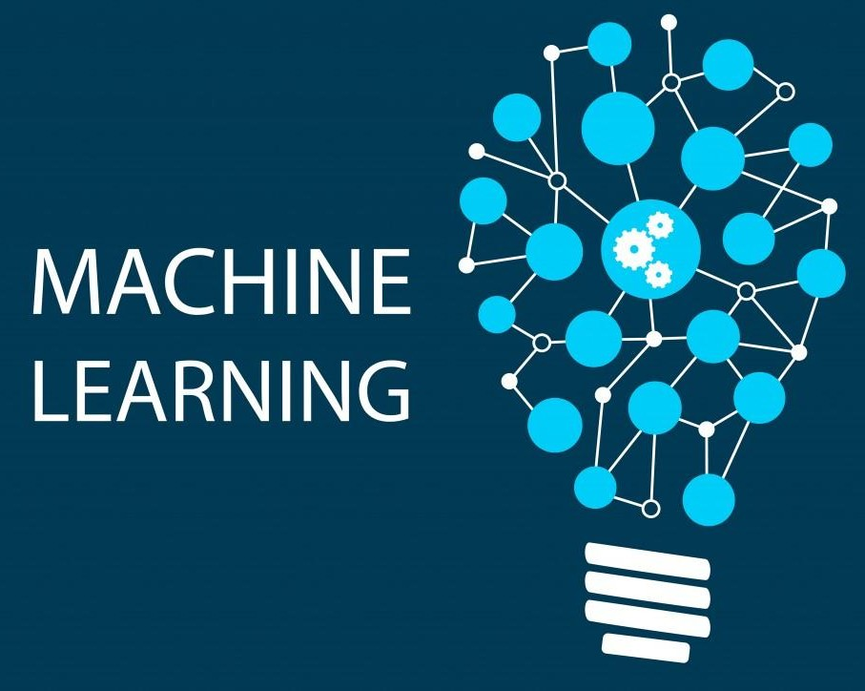
Machine Learning
Machine learning is the study of algorithms that learn from examples and experience instead of relying on hard-coded rules and make predictions on new data.

Slide 5
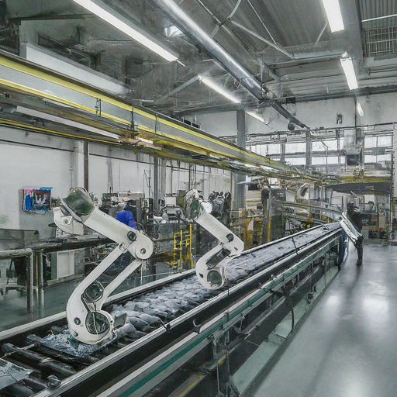
What is deep learning?
Deep learning is a subfield of machine learning focusing on learning data representations as successive layers of increasingly meaningful representations.

Slide 6

Image from https://blogs.nvidia.com/blog/2016/07/29/whats-difference-artificial-intelligence-machine-learning-deep-learning-ai/

Slide 7

“Traditional” machine learning:
handcrafted features
learned classifier
cat
Deep, “end-to-end” learning:
learned low-level features
learned mid-level features
learned high-level features
learned classifier
cat

Slide 8
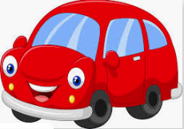


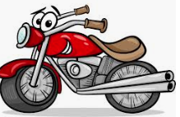
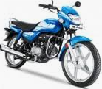
What is Machine Learning?
This what we called as Data or Training dataset
So, we first need to provide training dataset to the machine
+
Dataset

Slide 9

What is Machine Learning?
+
+
Then, devise algorithms and execute programs on the data With respect to the underlying target tasks
Dataset

Slide 10

What is Machine Learning?
+
+
+
Then, using the programs, Identify required rules
Dataset

Slide 11

What is Machine Learning?
+
+
+
Dataset
extract required patterns

Slide 12
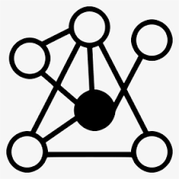
What is Machine Learning?
+
+
+
Dataset
Identify relations

Slide 13
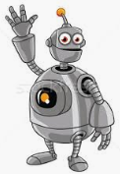
What is Machine Learning?
+
+
=
+
Dataset
So that machine can derive inferences from the data

Slide 14


In summary, what is machine learning?
Given a machine learning problem
Identify and create the appropriate dataset
Perform computation to learn
Required rules, pattern and relations
Output the decision

Slide 15
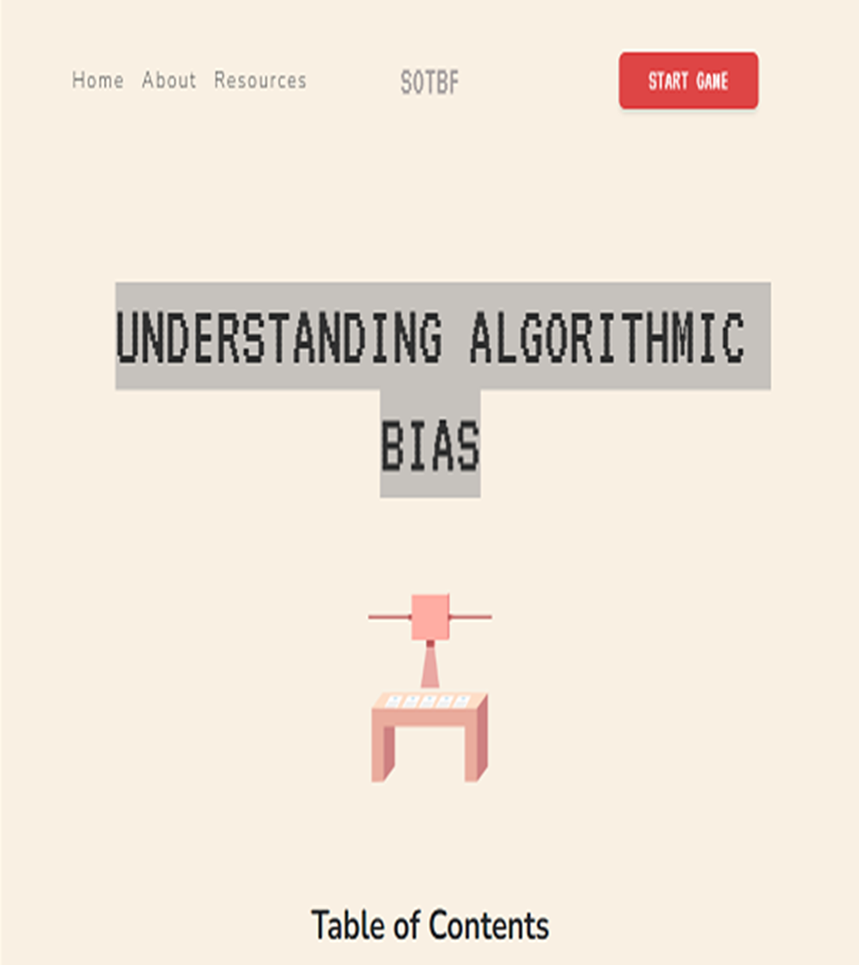
Play a Game
•Please navigate to the Understanding Algorithmic Bias https://www.survivalofthebestfit.com/resources
•Click “Start Game” and have a look at the end result.
•What do you think ?

Slide 16
Main types of machine learning

Slide 17
Machine Learning Paradigms
Supervised learning
Learning a mapping from a set of inputs to a target variable
Classification: target variable is discrete (e.g., spam email)
Regression: target variable is real-valued (e.g., stock market)
Unsupervised learning
No target variable provided
Clustering: grouping data into K groups
Other types of learning
Reinforcement learning: e.g., game-playing agent
Learning to rank, e.g., document ranking in Web search
And many others….
Notes:
[ We as human being solve various types of problem in our day-to-day life, < Various decisions need to be taken.
Depending on the nature of the problem, machine learning tasks can be broadly divided in ]

Slide 18
What is Supervised Learning?
CAR
+
CAR
=
Training Dataset
BIKE
BIKE
Samples
Labels
Notes:
[In supervised learning, we need some thing called a Labelled Training Dataset ]

Slide 19
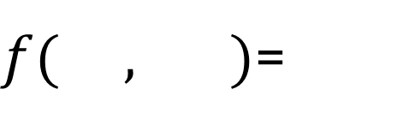
What is Supervised Learning?
CAR
+
CAR
=
$f( , )$=
Training Dataset
BIKE
BIKE
Samples
Labels
Notes:
[ Given a labelled dataset, the task is to devise a function which takes the dataset, and a new sample, and produces an output value.]

Slide 20
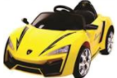
What is Supervised Learning?
CAR
+
CAR
=
$f( , )$=
Training Dataset
BIKE
BIKE
Samples
Labels
Notes:
[ Given a labelled dataset, the task is to devise a function which takes the dataset, and a new sample, and produces an output value.]

Slide 21
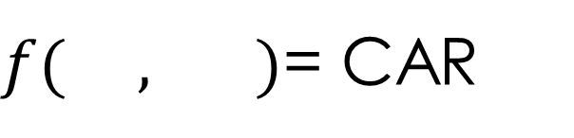
What is Supervised Learning?
CAR
+
CAR
=
$f( , )$= CAR
Training Dataset
BIKE
BIKE
Samples
Labels
Notes:
[ Given a labelled dataset, the task is to devise a function which takes the dataset, and a new sample, and produces an output value.]

Slide 22
What is Supervised Learning?
CAR
Classification
+
CAR
=
$f( , )$= CAR
Training Dataset
BIKE
BIKE
Samples
Labels
Notes:
[ If the possible output values of the function are predefined and discrete/categorical, it is called Classification

Slide 23
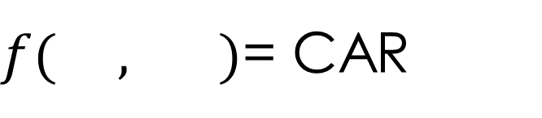
What is Supervised Learning?
CAR
Classification
+
CAR
=
$f( , )$= CAR
Training Dataset
BIKE
BIKE
Samples
Labels
Notes:
[ Predefined classes means, it will produce output only from the labels defined in the dataset. For example, even if we input a bus, it will produce either CAR or BIKE ]

Slide 24
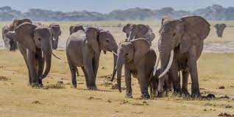
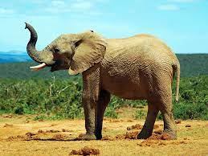
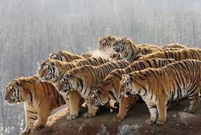
Classifier
Elephant
Elephant
Classifier
Tiger
Identify the Animal ?
Dataset

Slide 25
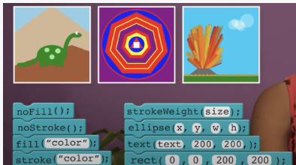
Play a Game
•Please navigate to the Understanding Algorithmic Bias
https://code.org/student/middle-high
•Click “Start Game” and have a look at the end result.
•What do you think ?

Slide 26
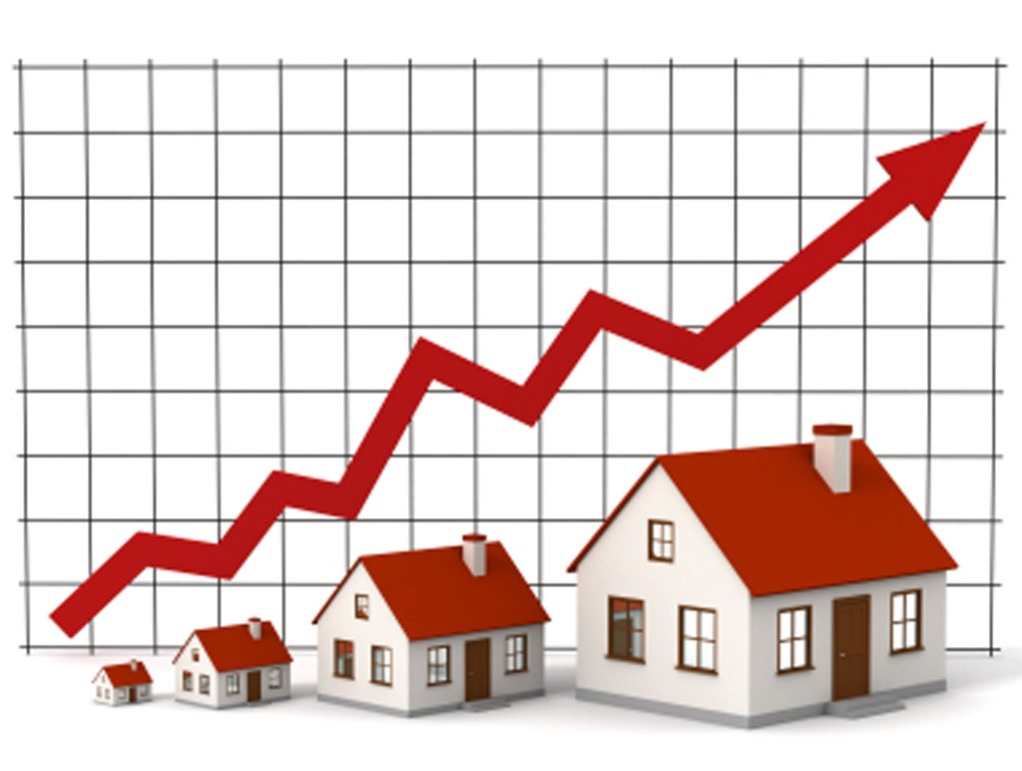
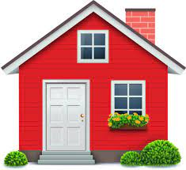
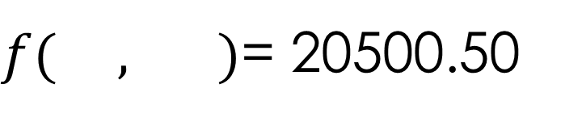
Regression
Regression
$f( , )$= 20500.50
Dataset
Notes:
[ If the possible output values of the function are continuous real values, then it is called Regression

Slide 27
Unsupervised Learning
In unsupervised learning, output variables are not known.
Unsupervised learning algorithms identify trends in data and make inferences without knowledge of correct answers.

Slide 28
What is Unsupervised Learning
CAR
CAR
BIKE
BIKE
Dataset
Notes:
[ In the unsupervised learning, we do not need to know the labels or Ground truth values ]

Slide 29
What is Unsupervised Learning
Clustering
Dataset
Notes:
[ The task is to identify the patterns like group the similar objects together ]

Slide 30

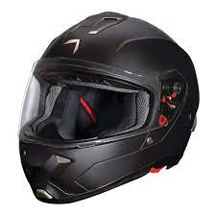
What is Unsupervised Learning
Association Rules Mining
Dataset
[ Association rules like ]

Slide 31
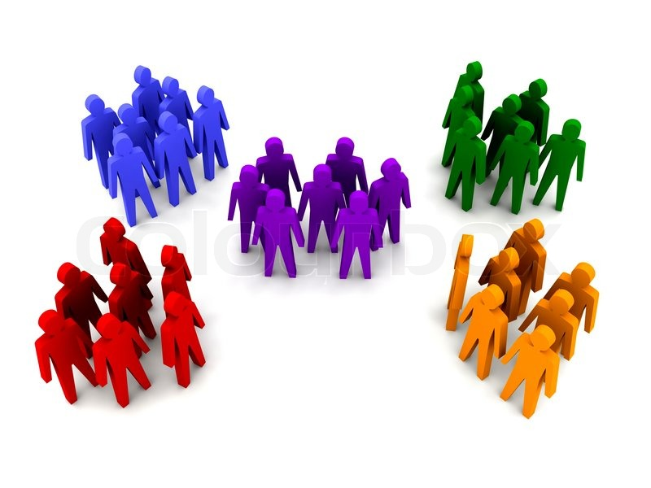
More Example Unsupervised Learning
Dataset

Slide 32
More Example Unsupervised Learning
Dataset

Slide 33
What is Clustering?
Unsupervised Learning Example
Clustering grouping unlabelled data

Slide 34
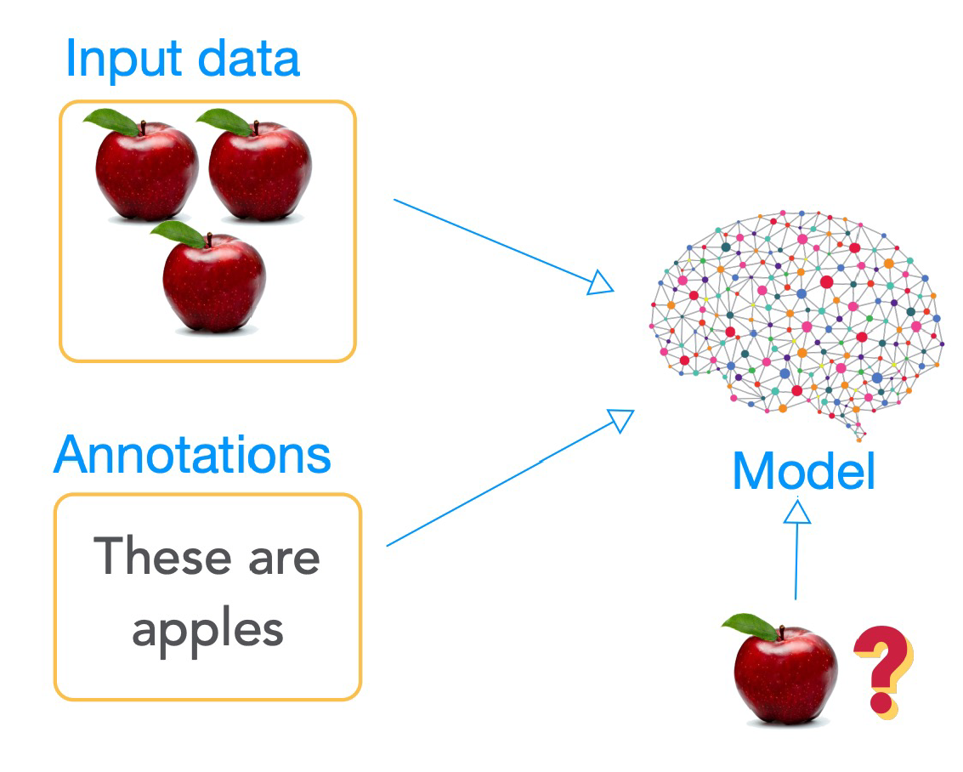
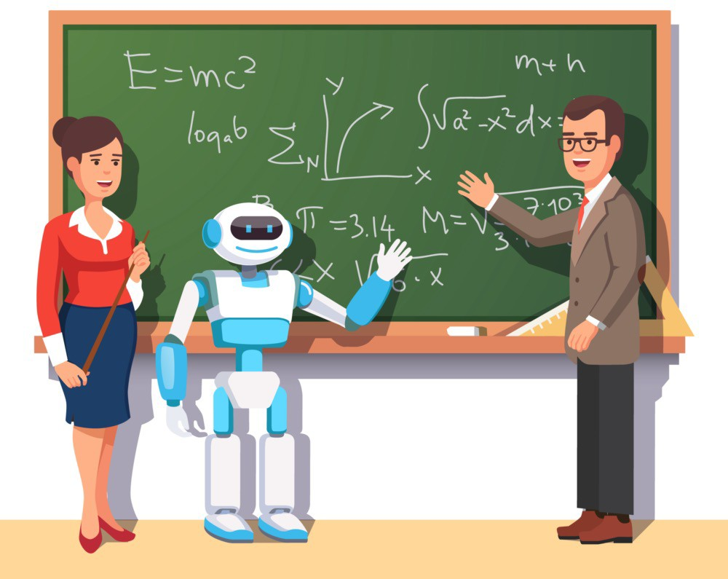
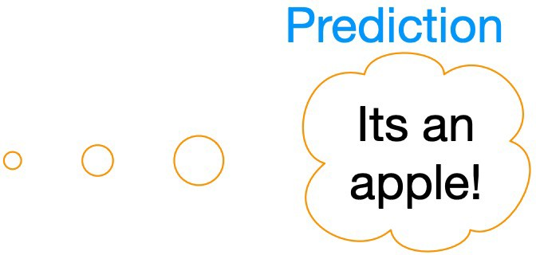
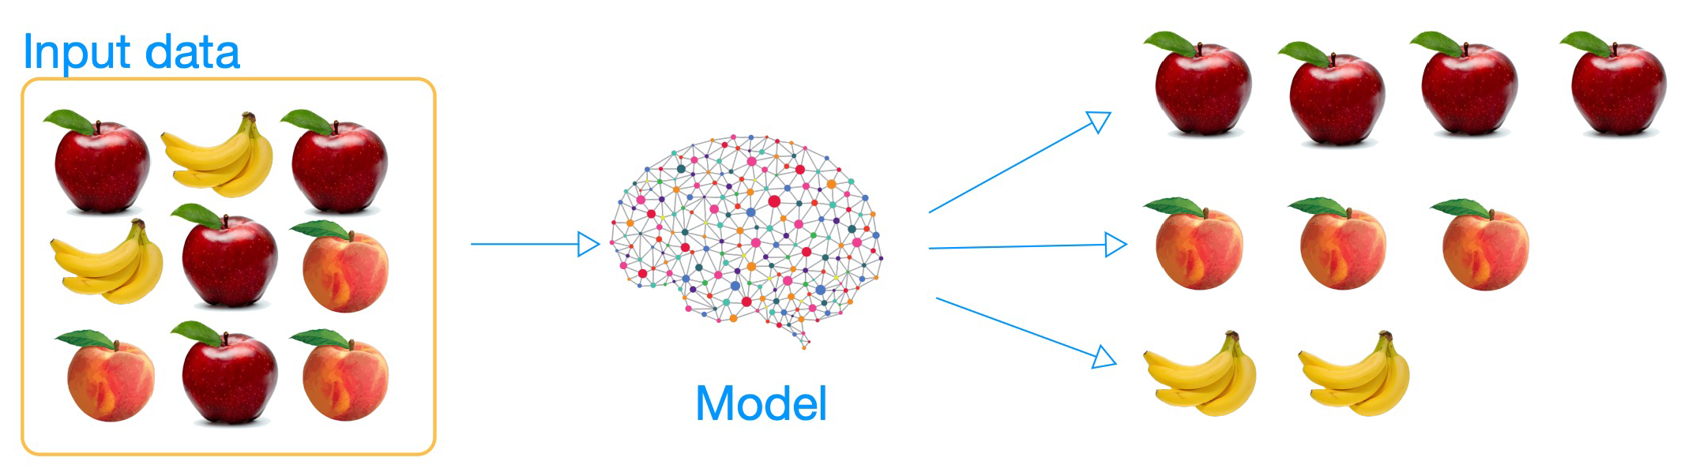

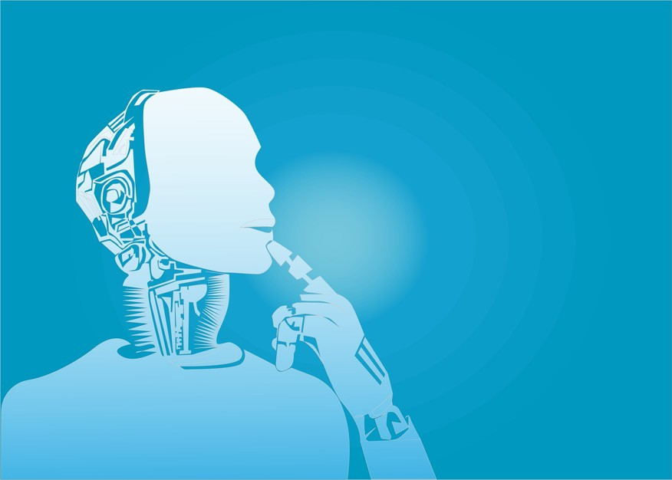
What is Clustering?
Supervised Learning
(e.g. Regression, Classification)
Unsupervised Learning
(e.g. Clustering)
Image source: mdpi.com/2073-8994/10/12/734

Slide 35
What is Clustering?
Spending Score
Spending Score
Clustering
Annual Income $
Annual Income $

Slide 36
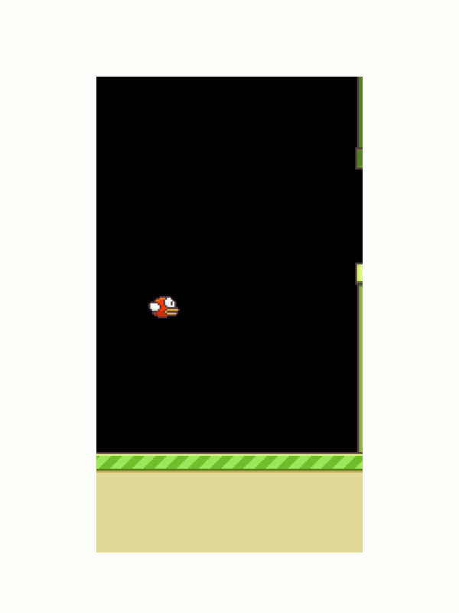
What is Reinforcement Learning
Reinforcement learning is concerned with how software ought to initiate actions in an environment so as to maximize some notion of long-term reward.
Reinforcement learning algorithms identify ways to maps states of the world to the actions the software ought to take in those states.
Reinforcement learning may involve learning from mistakes.
Animation from https://yanpanlau.github.io/2016/07/10/FlappyBird-Keras.html
Notes:
[ It is also known as learning from trials and errors ]

Slide 37


What is Reinforcement Learning

Slide 38
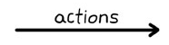
What is Reinforcement Learning

Slide 39
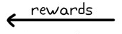
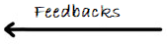
What is Reinforcement Learning

Slide 40
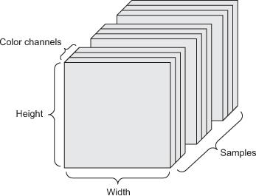
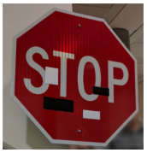
Data
Tensors: generalization of matrices to n dimensions (or rank, order, degree)
1D tensor: vector
2D tensor: matrix
3D, 4D, 5D tensors
numpy.ndarray(shape, dtype)
Training – validation – test split (+ adversarial test)
Minibatches
small sets of input data used at a time
usually processed independently
Image from: https://arxiv.org/abs/1707.08945

Slide 41
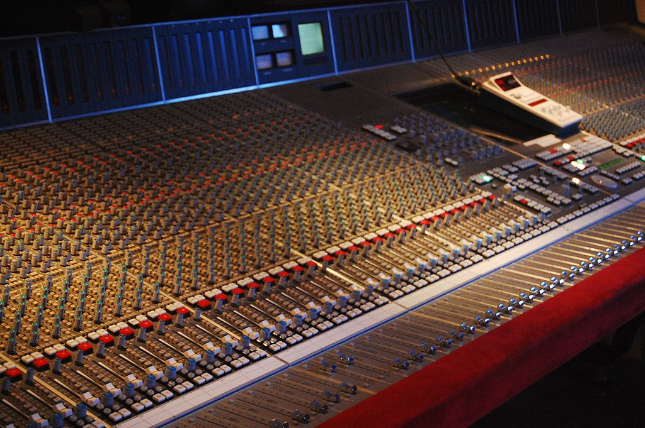
Optimization
Mathematical optimization: “the selection of a best element (with regard to some criterion) from some set of available alternatives” (Wikipedia)
Main types: finite-step, iterative, heuristic
By Rebecca Wilson (originally posted to Flickr as Vicariously) [CC BY 2.0], via Wikimedia Commons

Slide 42
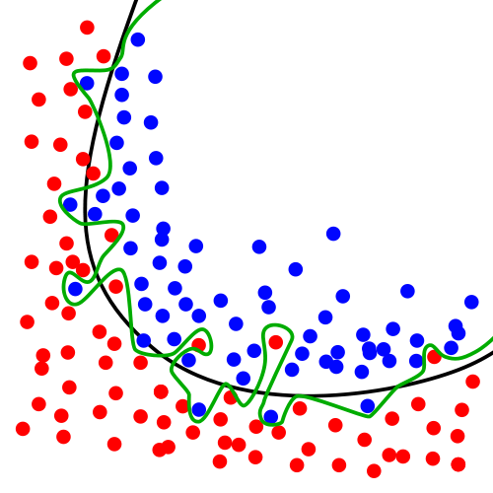
Over- and underfitting, generalization, regularization
Models with lots of parameters can easily overfit to training data
Generalization: the quality of ML model is measured on new, unseen samples
Regularization: any method* to prevent overfitting
simplicity, sparsity, dropout, early stopping
*) other than adding more data
By Chabacano [GFDL or CC BY-SA 4.0], from Wikimedia Commons

Slide 43
Deep learning

Slide 44
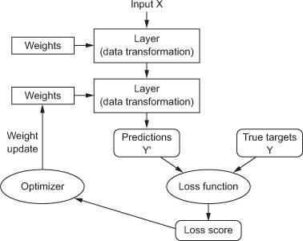
Anatomy of a deep neural network
Layers
Input data and targets
Loss function
Optimizer

Slide 45
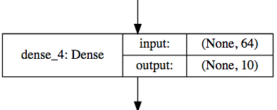
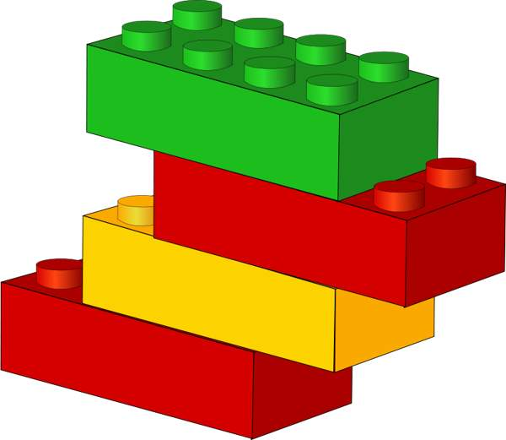
Layers
Data processing modules
Many different kinds exist
densely connected
convolutional
recurrent
pooling, flattening, merging, normalization, etc.
Input: one or more tensors output: one or more tensors
Usually have a state, encoded as weights
learned, initially random
When combined, form a network or a model

Slide 46
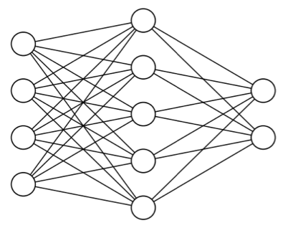
Input data and targets
The network maps the input data X to predictions Y′
During training, the predictions Y′ are compared to true targets Y using the loss function
cat
dog

Slide 47
Loss function
The quantity to be minimized (optimized) during training
the only thing the network cares about
there might also be other metrics you care about
Common tasks have “standard” loss functions:
mean squared error for regression
binary cross-entropy for two-class classification
categorical cross-entropy for multi-class classification
etc.

Slide 48
Anatomy of a deep neural network

Slide 49
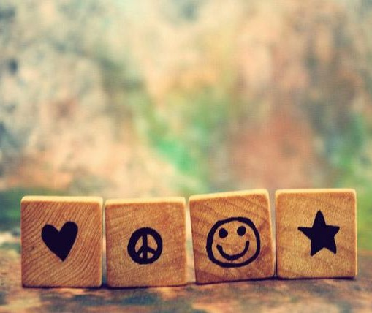
Benefits of A.I.
The most important purpose of
A.I. is to reduce human casualties in
Wars
Dangerous Workspaces
Car Accidents
Natural Disasters
Or to just make everyday life easier by helping with tasks such as:
Cleaning
Shopping
Transportation

Slide 50

what are the disadvantages of AI?
Lack of Transparency → lying about using AI
Bias and Discrimination → assumtion based of incorrect
Privacy Concerns Ethical Dilemmas Security Risks Concentration of Power Dependence on AI
Job Displacement
information

Slide 51
how can we use ai responsibly?
People should use their own creativity, not copy off of AI! AI is just a tool for efficiency!
Consider data and privacy goals
Put People First
Minimize unintended bias
Ensure AI transparency

Slide 52
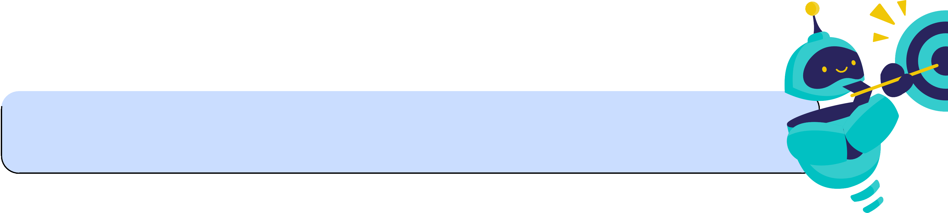
REsponsible Ai USe
AI can help do repetitive work for humans, but humans should still be prioritized.
Create a culture that utilizes creativity, empathy, and dexterity from humans and AI for increased efficiency.
Businesses should adopt strong security measures, limit access to sensitive data, and anonymize data whenever possible to secure data privacy with AI and ML technologies.
There needs to be fairness in AI which entails identifying and eliminating discrimination while also encouraging diversity and inclusion. This is can be done by using training models with equal representation.
Develop explainable AI that is visible across processes and functions to generate trust among employees and customers. Provide examinability, comprehension, and traceability.

Slide 53


Further resources
Recommended textbook: “Deep learning” by Goodfellow, Bengio, Courville
Lots of further material available online, e.g.: http://cs231n.stanford.edu/ http://course.fast.ai/ https://developers.google.com/machine-learning/crash-course/ www.nvidia.com/dlilabs http://introtodeeplearning.com/ https://github.com/oxford-cs-deepnlp-2017/lectures, https://jalammar.github.io/

Slide 54
Thank you!

